Slide 1
DCDSL PROJECT AY 2025-26
Phase 2 Presentation
Title of the Project:Data-Driven Insights on BookMyShow
Group Members:
Kashish Chelwani 24070126082
Kavish Nag 24070126085
Kunal Jhindal 24070126098
Practical Batch: B1
Subject Teacher:
Dr. Pooja Kamat
Department of Artificial Intelligence & Machine Learning
1

Slide 2

Outline of the Presentation
Names of all the group members and their work distribution
Introduction
Problem Statement
Objectives of the Project
Methodology
ER Diagram
ER Diagram To Relational Schema Conversion
Database Table Creation and Data Insertion
Basic and Advanced Query Implementation
Python Desktop / Web Application
Project Outcome
Conclusion
References
A photograph of the phase 1 presentation.
Department of Artificial Intelligence & Machine Learning
2

Slide 3
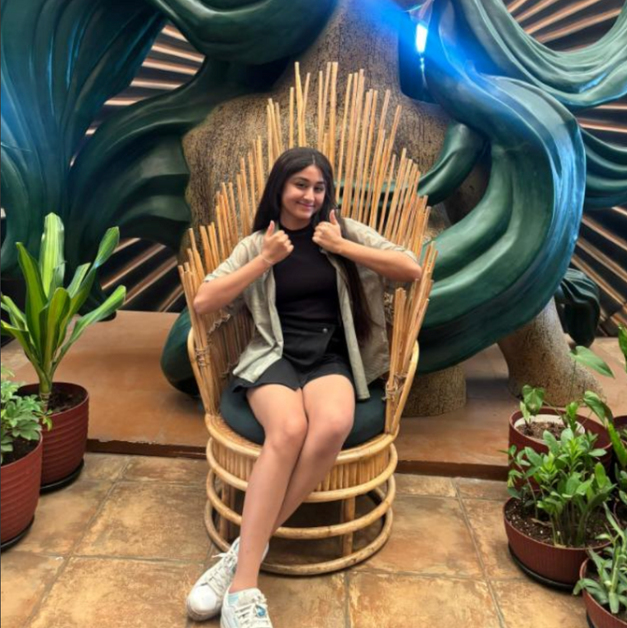

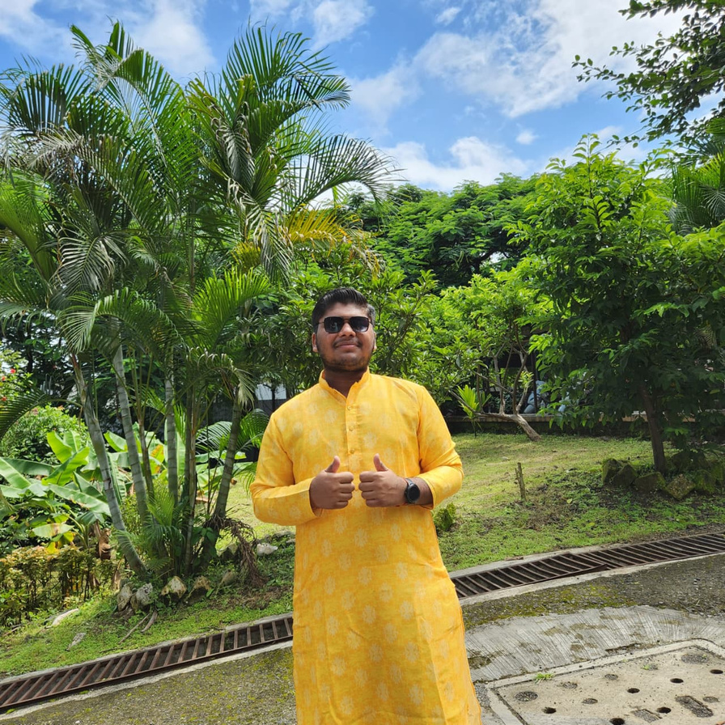
Group Members
KASHISH CHELWANI
KAVISH NAG
KUNAL JHINDAL
24070126082
24070126085
24070126098
ER Diagrams, insertion and queries, Website
Scheme creation, insertion and queries, Website
Tables creation , insertion and queries, Python script,Website
4-11-25
Department of Artificial Intelligence & Machine Learning
3

Slide 4
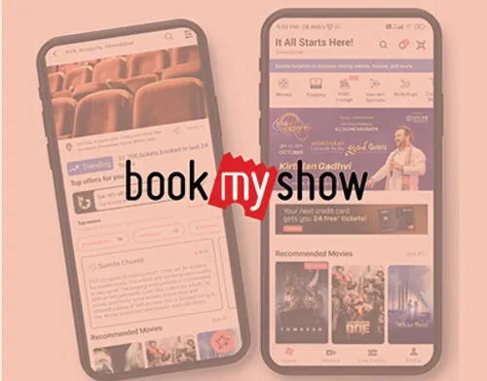

Introduction
BookMyShow is one of India’s largest online ticket booking platforms, enabling users to book tickets for movies, events, and live shows. With millions of users, the platform generates vast amounts of data on user behavior, movie performance, theater occupancy, payment transactions, and customer reviews.
This project uses SQL-based analysis to explore the BookMyShow dataset and uncover meaningful insights that can help enhance platform efficiency, improve customer experience, and maximize revenue generation.
4-11-25
Department of Artificial Intelligence & Machine Learning
4

Slide 5

Problem Statement
BookMyShow, as a leading online ticketing platform, manages millions of users, theaters, movies, and transactions daily. However, the platform faces challenges in effectively understanding user behavior, movie performance, theater efficiency, seat utilization, revenue management, and payment reliability. While vast amounts of data are generated, critical issues remain:
Identifying patterns in user engagement and retention
Measuring and improving movie success metrics and theater performance
Optimizing seat utilization and dynamic pricing strategies
Detecting bottlenecks in revenue generation and transaction failures
Leveraging reviews and sentiment analysis to improve customer satisfaction
Addressing these challenges requires SQL-based analytical insights to uncover trends, highlight inefficiencies, and provide data-driven strategies. The ultimate goal is to enhance platform performance, boost revenue, and deliver a seamless user experience.
4-11-25
Department of Artificial Intelligence & Machine Learning
5

Slide 6

Objectives
Analyze user engagement to identify most active users and improve retention.
Evaluate movie and theater performance for better scheduling and marketing.
Track revenue generation across months, users, and payment methods.
Study seat utilization to align pricing strategy with demand.
Assess payment system reliability by identifying transaction failures.
Examine customer reviews and ratings to enhance content offerings.
4-11-25
Department of Artificial Intelligence & Machine Learning
6

Slide 7








Methodology
1
2
3
4
5
DATA COLLECTION
DATABASE DESIGN
SCHEMA CONVERSION
DATA INSERTION
QUERY IMPLEMENTATION
Gathered sample BookMyShow dataset containing user, movie, theater, booking, payment, and review data.
Constructed ER diagram to represent relationships among entities (Users, Movies, Theaters, Bookings, Payments, Reviews, Seats).
Populated tables with sample records.
Wrote SQL queries for both basic operations (SELECT, JOIN, GROUP BY) and advanced analysis (window functions, CTEs, subqueries).
Converted ER model into relational schema (tables with primary & foreign keys).
6
7
WEBSITE CREATION
OUTCOME & CONCLUSION
Development of desktop / web application
Derived insights to optimize engagement, revenue, and customer satisfaction.
4-11-25
Department of Artificial Intelligence & Machine Learning
7

Slide 8
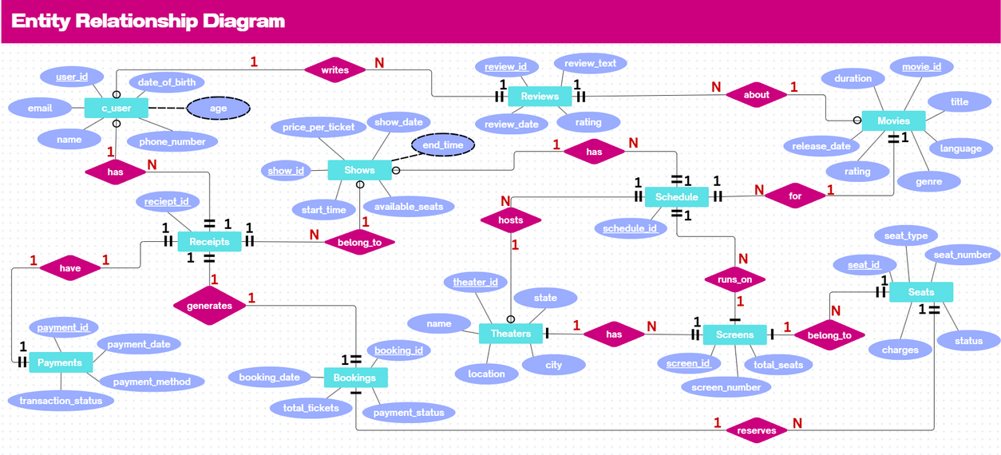
4-11-25
Department of Artificial Intelligence & Machine Learning
8

Slide 9
Relational Scheme
Payments
Theaters
Reviews
Bookings
payement_id
payement_method
payment_date
transaction_status
theater_id
name
location
city
state
review_id
user_id
movie_id
rating
review_text
review_date
booking_id
booking_date
total_tickets
payment_status
shows
c_user
screens
Seats
seat_id
booking_id
screen_id
seat_number
seat_type
charger
status
show_id
show_date
start_time
price_per_ticket
available_seats
user_id
c_name
email
phone_number
DOB
screen_id
screen_number
total_Seats
Schedule
Movies
Reciepts
schedule_id
show_id
movie_id
theater_id
screen_id
movie_id
title
genre
m_lang
duration
rating
release_date
Reciept_id
Booking_id
user_id
show_id
payment_id
4-11-25
Department of Artificial Intelligence & Machine Learning
9

Slide 10
Creation
USER_ID
CREATE TABLE c_user (user_id VARCHAR(20) PRIMARY KEY, name VARCHAR(100), email VARCHAR(100) UNIQUE, phone_number BIGINT, date_of_birth DATE);
Movies
CREATE TABLE Movies (movie_id VARCHAR(20) PRIMARY KEY, title VARCHAR(200), genre VARCHAR(50), language VARCHAR(50), duration INT, rating
DECIMAL(3,1), release_date DATE);
Theater_id
CREATE TABLE Theaters (theater_id VARCHAR(20) PRIMARY KEY, name VARCHAR(100), location VARCHAR(100), city VARCHAR(100), state VARCHAR(100));
Screens
CREATE TABLE Screens (screen_id VARCHAR(20) PRIMARY KEY, screen_number INT, total_seats INT);
Shows
CREATE TABLE Shows (show_id VARCHAR(20) PRIMARY KEY, show_date DATE, start_time TIME, price_per_ticket DECIMAL(8,2), available_seats INT);
Schedule
CREATE TABLE Schedule (schedule_id VARCHAR(20) PRIMARY KEY, show_id VARCHAR(20), movie_id VARCHAR(20), theater_id VARCHAR(20), screen_id VARCHAR(20), FOREIGN KEY (show_id) REFERENCES Shows(show_id), FOREIGN KEY (movie_id) REFERENCES Movies(movie_id), FOREIGN KEY (theater_id) REFERENCES Theaters(theater_id), FOREIGN KEY (screen_id) REFERENCES Screens(screen_id));
4-11-25
Department of Artificial Intelligence & Machine Learning
10

Slide 11
Creation
Bookings
CREATE TABLE Bookings (booking_id VARCHAR(20) PRIMARY KEY, booking_date DATETIME, total_tickets INT, payment_status VARCHAR(50));
Seats
CREATE TABLE Seats (seat_id VARCHAR(20) PRIMARY KEY, booking_id VARCHAR(20), screen_id VARCHAR(20), seat_number VARCHAR(10), seat_type VARCHAR(20), charges DECIMAL(8,2), status VARCHAR(20), FOREIGN KEY (booking_id) REFERENCES Bookings(booking_id), FOREIGN KEY (screen_id) REFERENCES Screens(screen_id));
Payments
CREATE TABLE Payments (payment_id VARCHAR(20) PRIMARY KEY, payment_method VARCHAR(50), payment_date DATETIME, transaction_status VARCHAR(50));
Reciepts
CREATE TABLE Reciepts (reciept_id VARCHAR(20) PRIMARY KEY, booking_id VARCHAR(20), user_id VARCHAR(20), show_id VARCHAR(20), payment_id VARCHAR(20), FOREIGN KEY (booking_id) REFERENCES Bookings(booking_id), FOREIGN KEY (user_id) REFERENCES c_user(user_id), FOREIGN KEY (show_id) REFERENCES Shows(show_id), FOREIGN KEY (payment_id) REFERENCES Payments(payment_id));
Reviews
CREATE TABLE Reviews (review_id VARCHAR(20) PRIMARY KEY, user_id VARCHAR(20), movie_id VARCHAR(20), rating DECIMAL(3,1), review_text TEXT, review_date DATETIME, FOREIGN KEY (user_id) REFERENCES c_user(user_id), FOREIGN KEY (movie_id) REFERENCES Movies(movie_id));
4-11-25
Department of Artificial Intelligence & Machine Learning
11

Slide 12
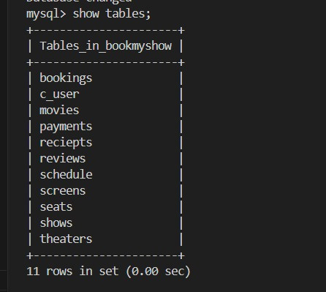
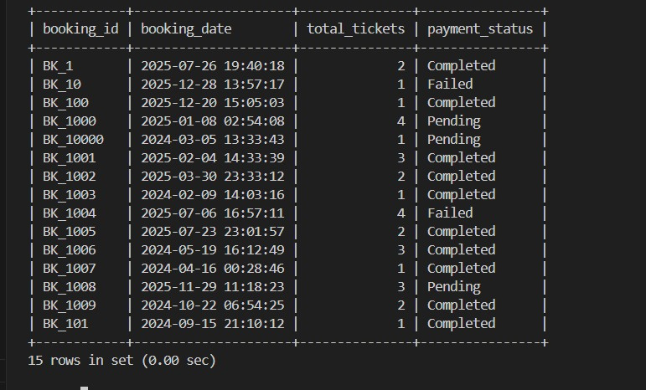
Insertion
Bookings
4-11-25
Department of Artificial Intelligence & Machine Learning
12

Slide 13
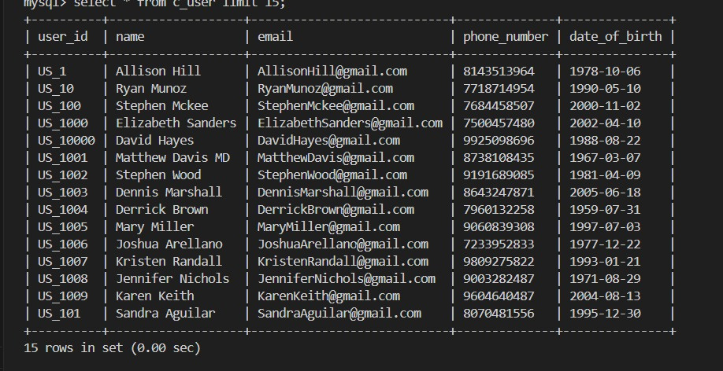
Insertion
c_user
4-11-25
Department of Artificial Intelligence & Machine Learning
13

Slide 14
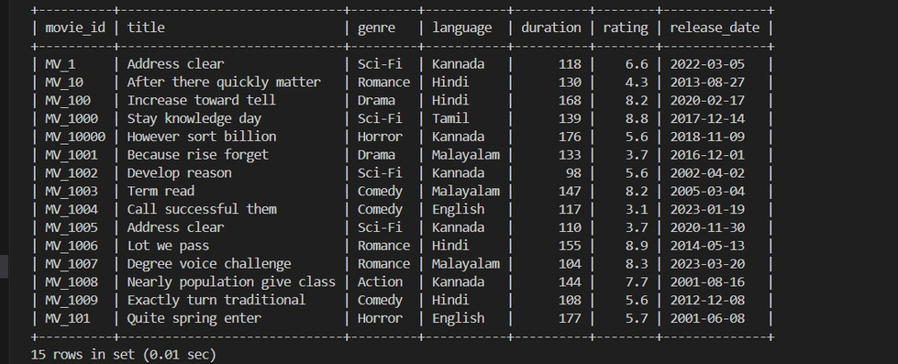
Insertion
movies
4-11-25
Department of Artificial Intelligence & Machine Learning
14

Slide 15
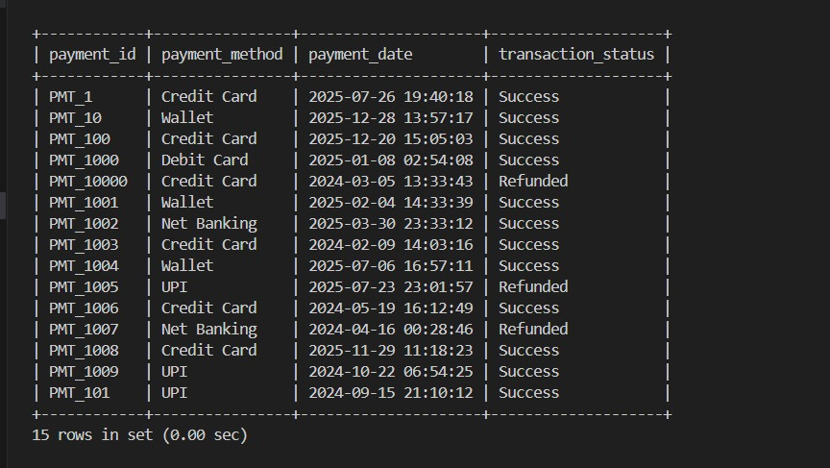
Insertion
payment
4-11-25
Department of Artificial Intelligence & Machine Learning
15

Slide 16
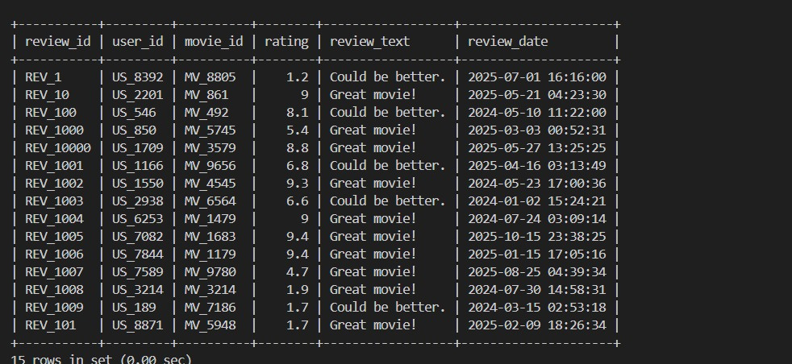
Insertion
review
4-11-25
Department of Artificial Intelligence & Machine Learning
16

Slide 17
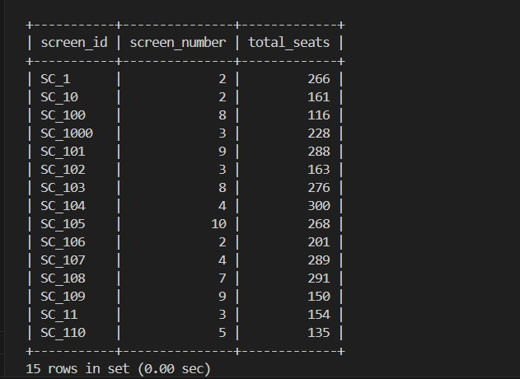
Insertion
screen
4-11-25
Department of Artificial Intelligence & Machine Learning
17

Slide 18
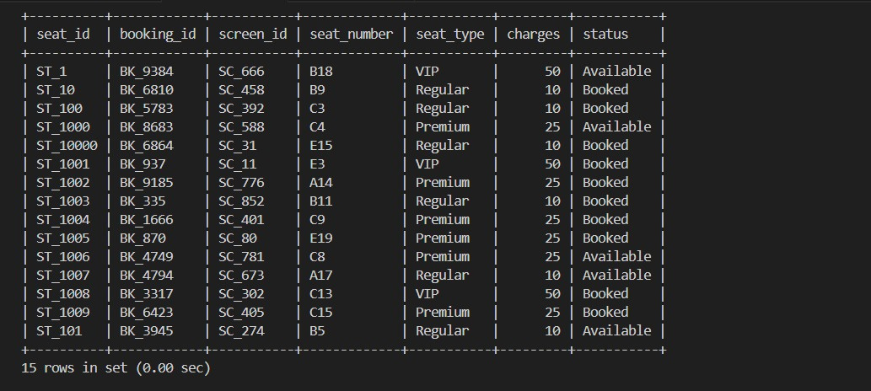
Insertion
seat
4-11-25
Department of Artificial Intelligence & Machine Learning
18

Slide 19
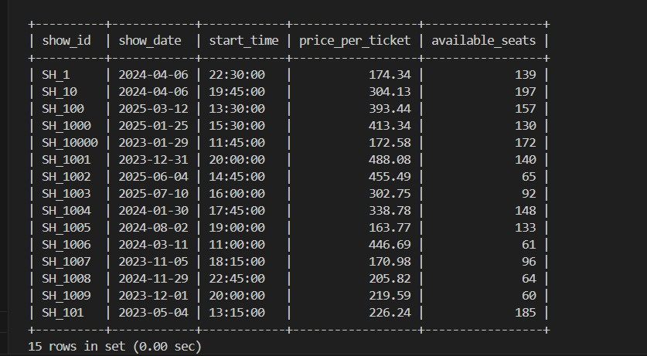
Insertion
show
4-11-25
Department of Artificial Intelligence & Machine Learning
19

Slide 20
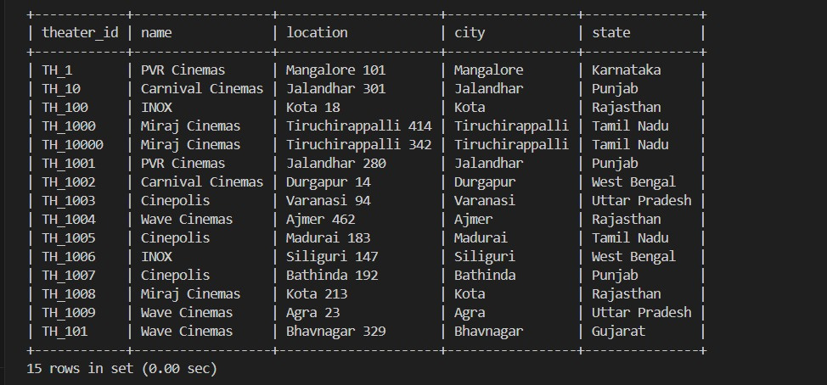
Insertion
theater
4-11-25
Department of Artificial Intelligence & Machine Learning
20

Slide 21
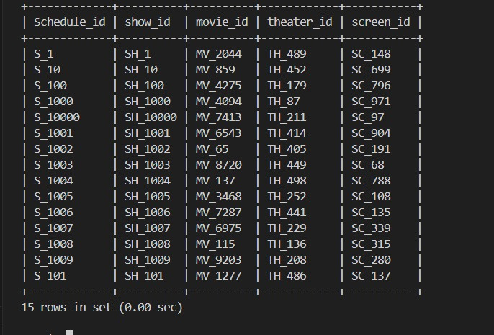
Insertion
Schedule
4-11-25
Department of Artificial Intelligence & Machine Learning
21

Slide 22
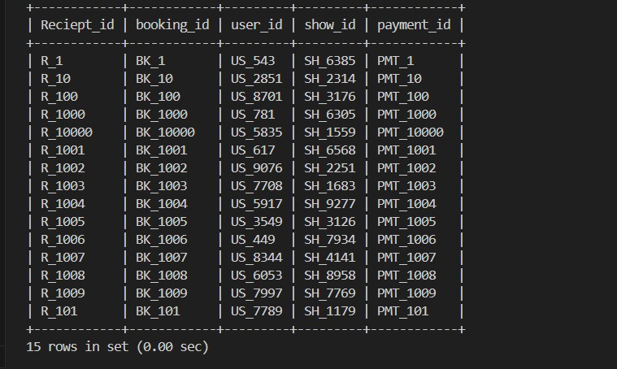
Insertion
Reciept
4-11-25
Department of Artificial Intelligence & Machine Learning
22

Slide 23
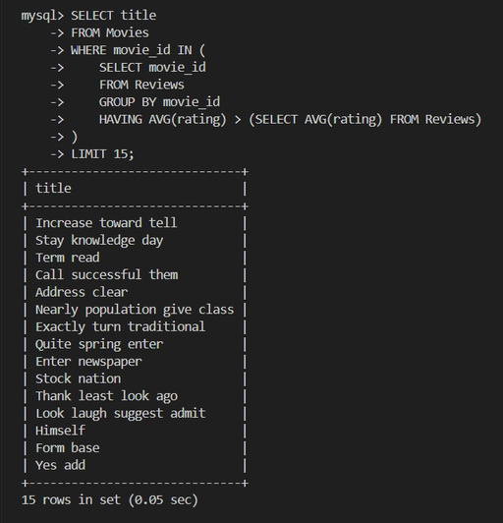
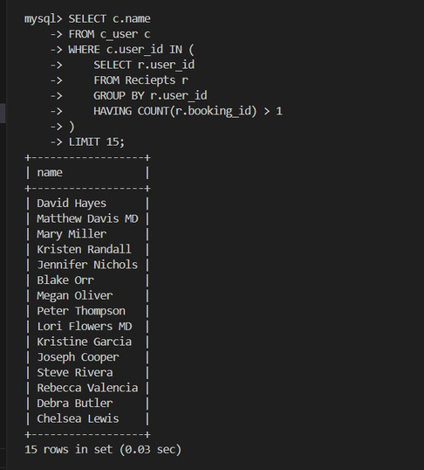
Sub Queries
Find movies that have average rating greater than overall average rating
List users who have made more than 1 booking
4-11-25
Department of Artificial Intelligence & Machine Learning
23

Slide 24
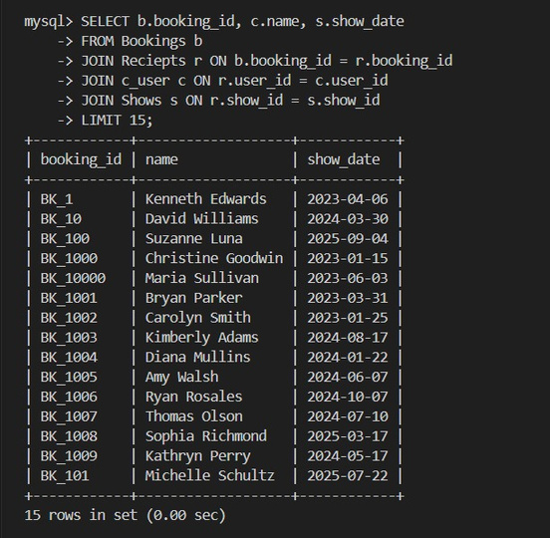
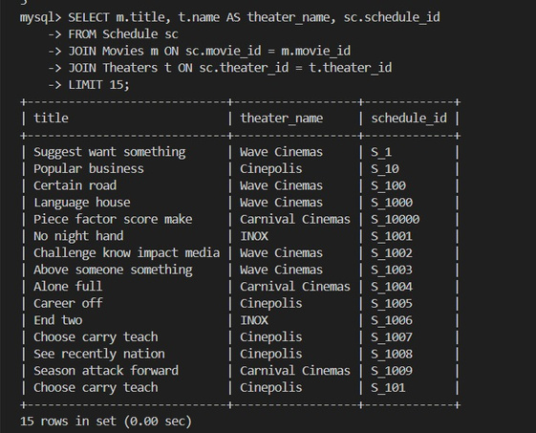
Join Queries
List all bookings with the user’s name and show date
Get all movies and the theaters they are scheduled in
4-11-25
Department of Artificial Intelligence & Machine Learning
24

Slide 25
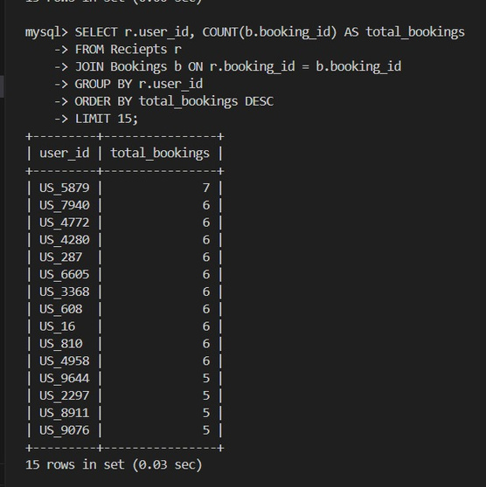
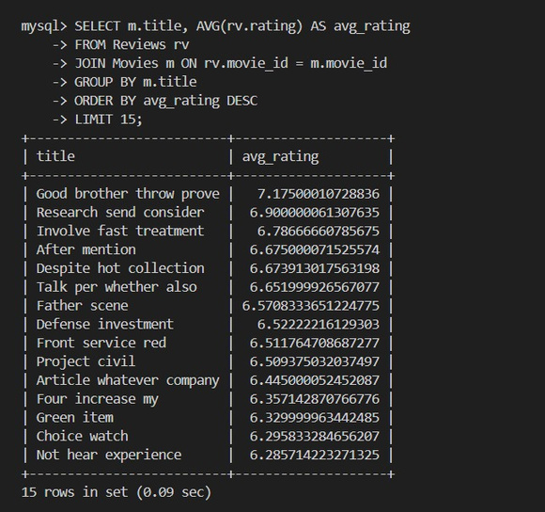
Group by,Having by,Queries
Count number of bookings per user, order by most bookings
Get average rating for each movie, order by highest first
4-11-25
Department of Artificial Intelligence & Machine Learning
25

Slide 26
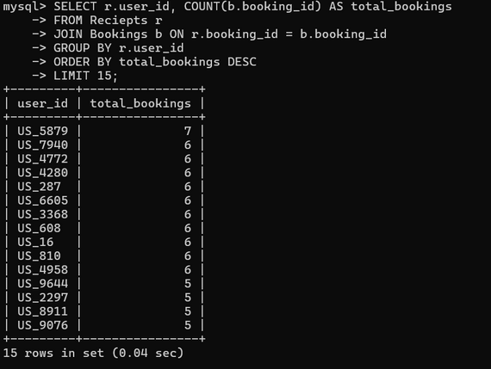
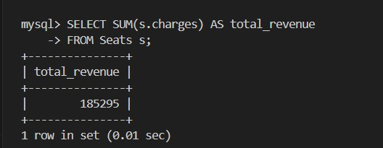
Aggregate Queries
(Find total seats booked per booking
Calculate total revenue collected (sum of charges)
4-11-25
Department of Artificial Intelligence & Machine Learning
26

Slide 27
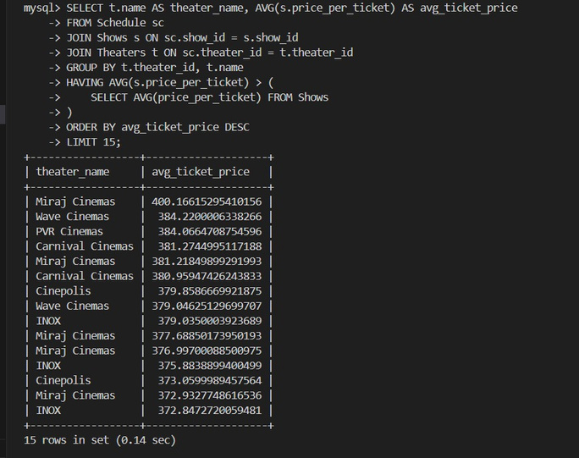
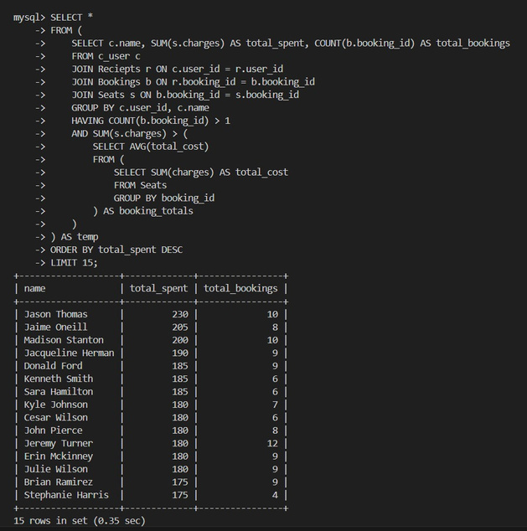
Advanced Queries
Find theaters where the average ticket price is above the overall average ticket price
Get users who booked more than 1 ticket total, and show their total spend (using subquery for charges)
4-11-25
Department of Artificial Intelligence & Machine Learning
27

Slide 28
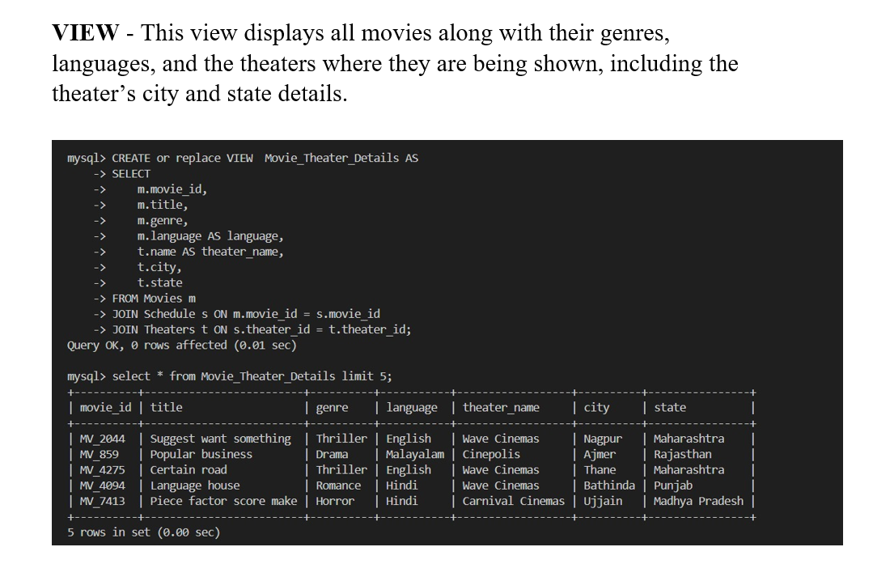
Advanced Queries
4-11-25
Department of Artificial Intelligence & Machine Learning
27

Slide 29
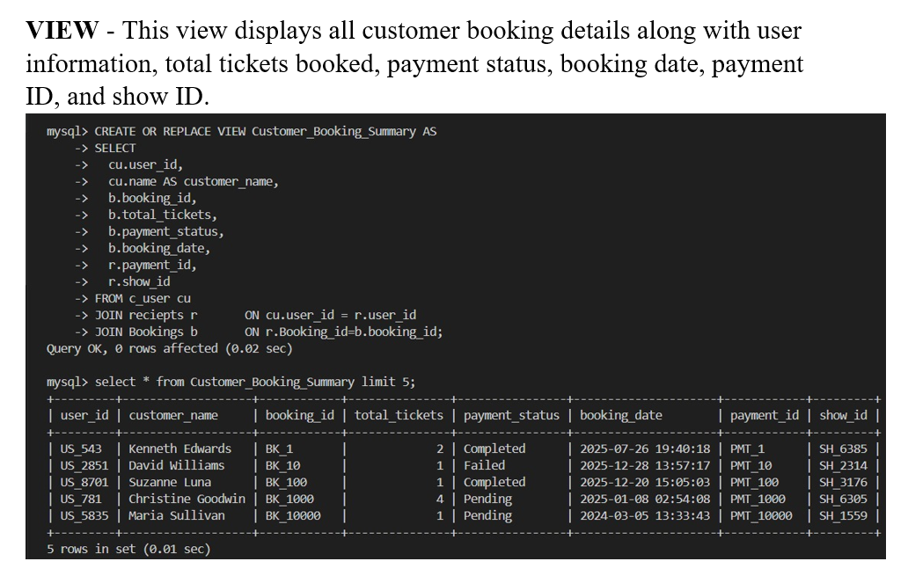
Advanced Queries
4-11-25
Department of Artificial Intelligence & Machine Learning
27

Slide 30
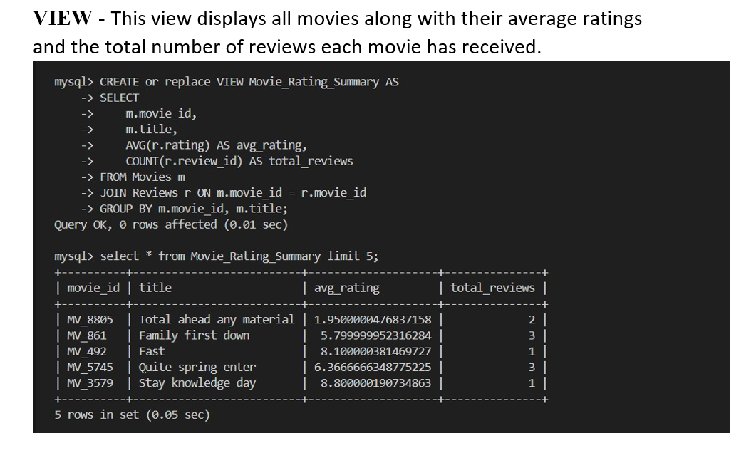
Advanced Queries
4-11-25
Department of Artificial Intelligence & Machine Learning
27

Slide 31
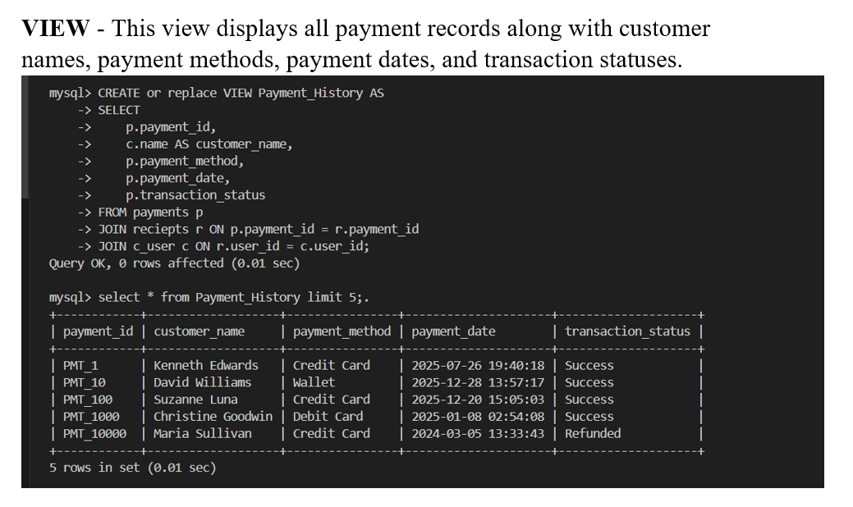
Advanced Queries
4-11-25
Department of Artificial Intelligence & Machine Learning
27

Slide 32
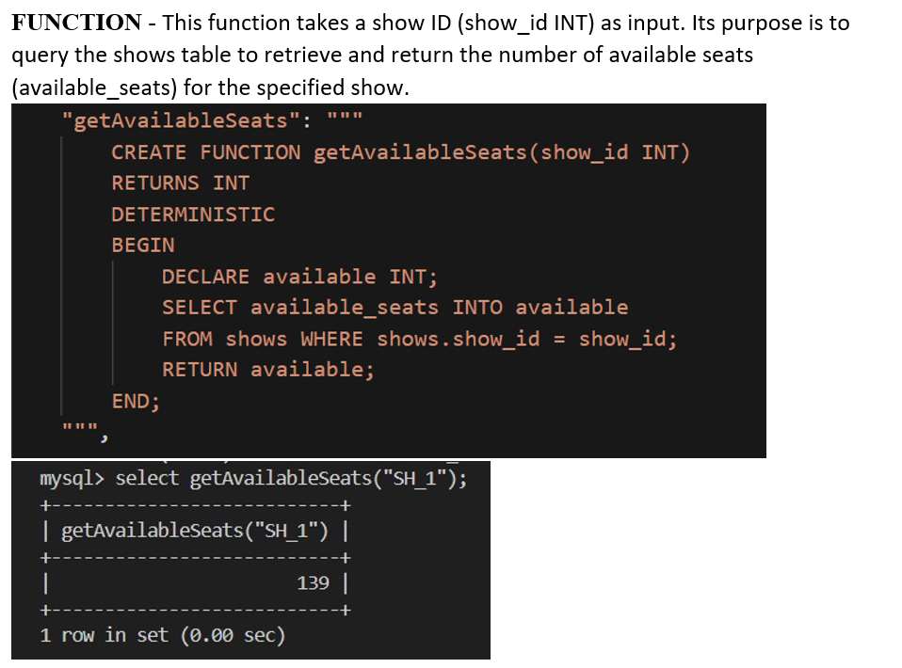
Advanced Queries
4-11-25
Department of Artificial Intelligence & Machine Learning
27

Slide 33
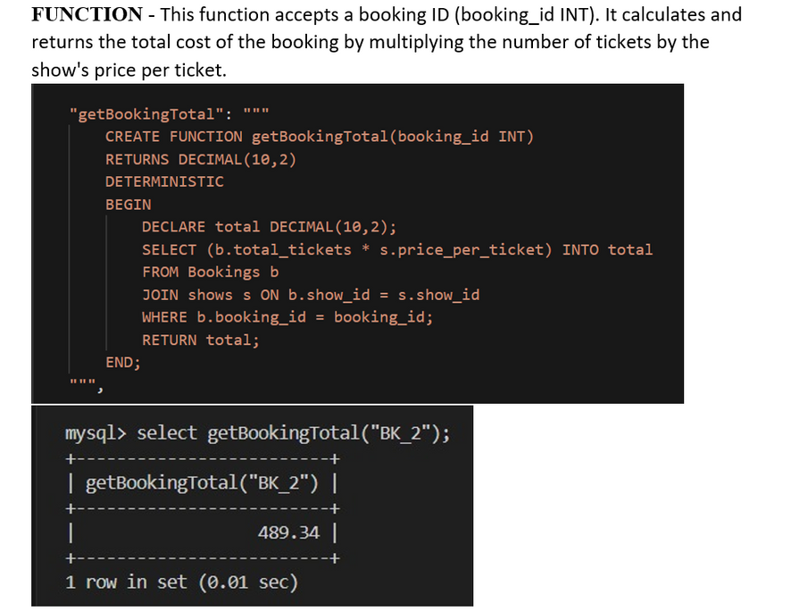
Advanced Queries
4-11-25
Department of Artificial Intelligence & Machine Learning
27

Slide 34
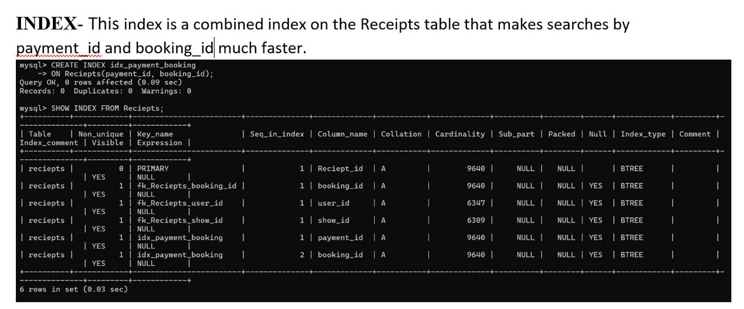
Advanced Queries
4-11-25
Department of Artificial Intelligence & Machine Learning
27

Slide 35
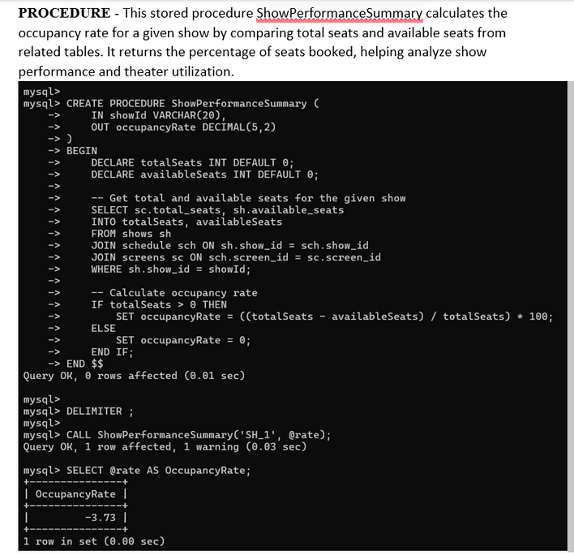
Advanced Queries
4-11-25
Department of Artificial Intelligence & Machine Learning
27

Slide 36
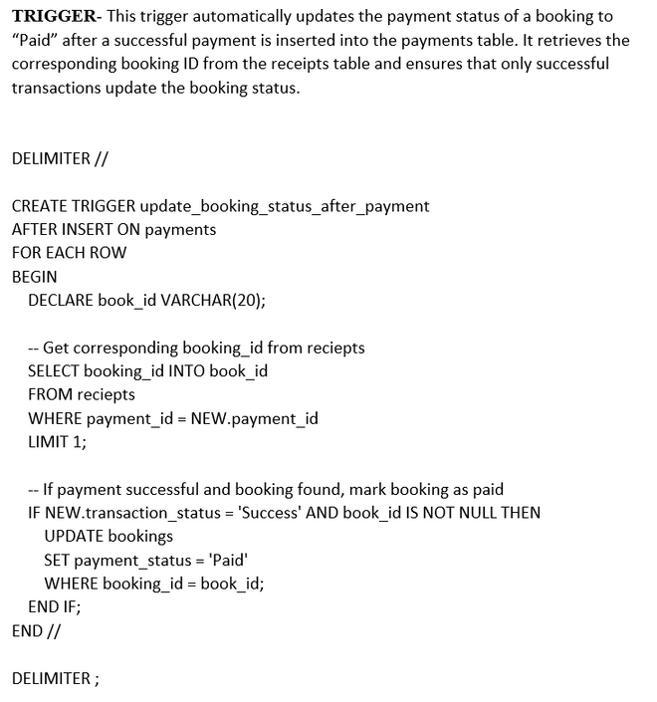
Advanced Queries
4-11-25
Department of Artificial Intelligence & Machine Learning
27

Slide 37
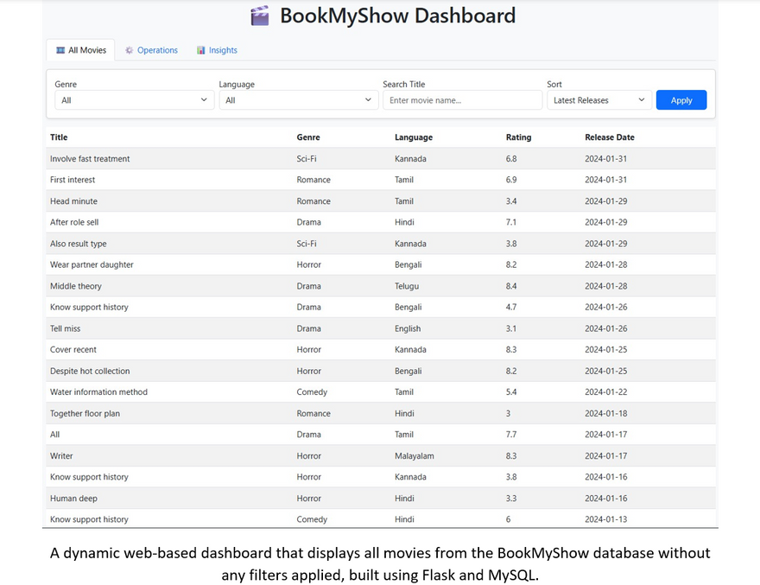
Python Desktop / Web Application
03-09-2025
Department of Artificial Intelligence & Machine Learning
28

Slide 38
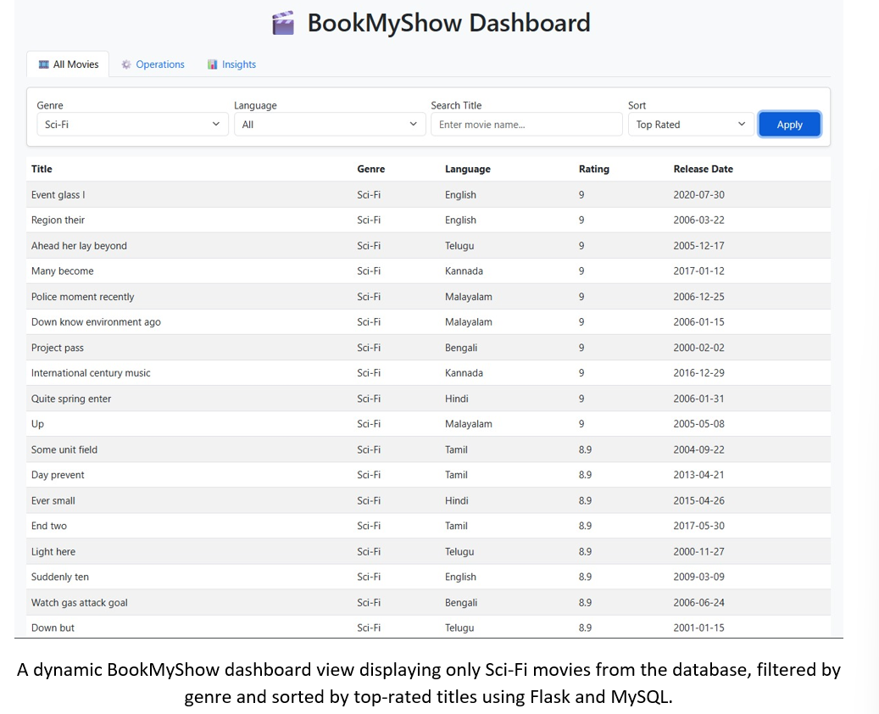

Slide 39
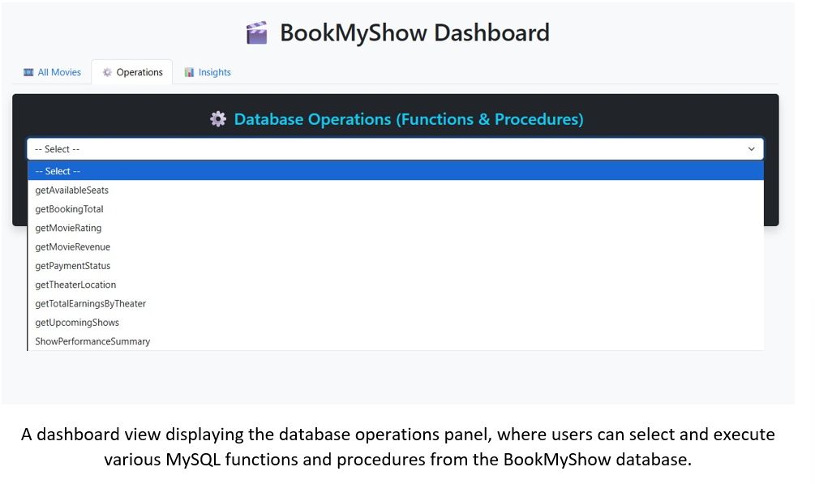

Slide 40
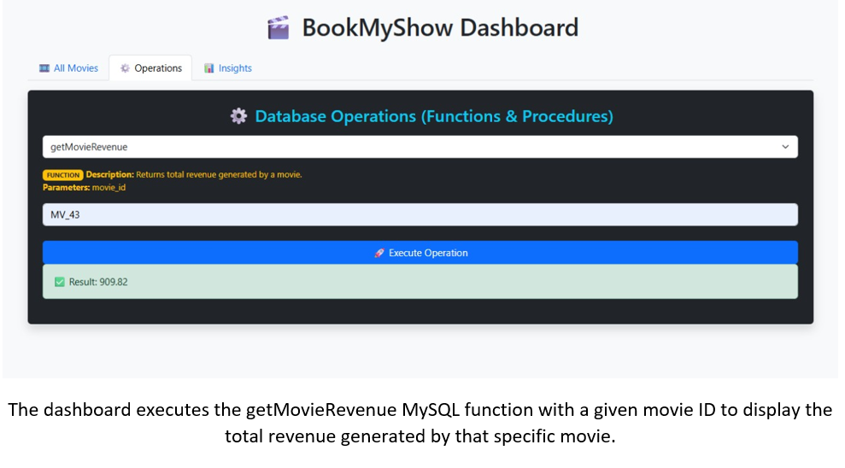

Slide 41
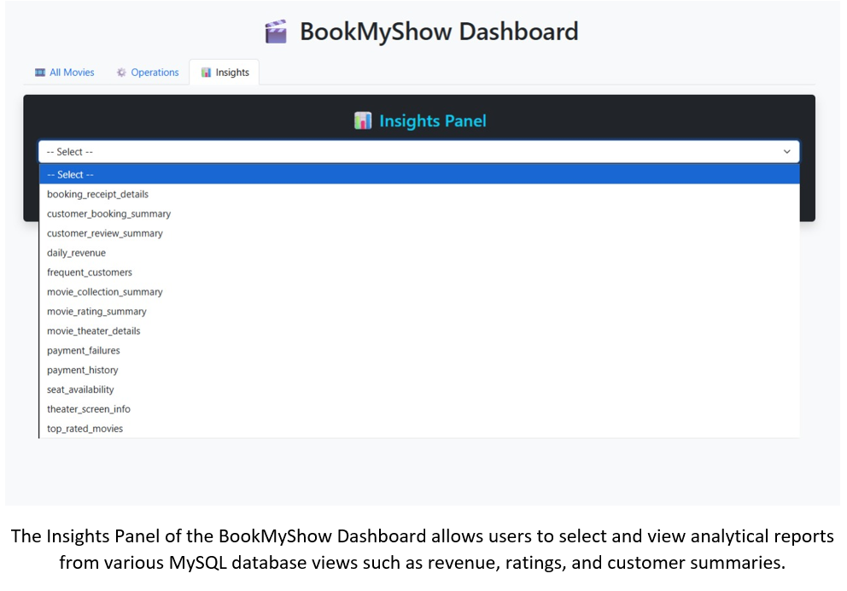

Slide 42
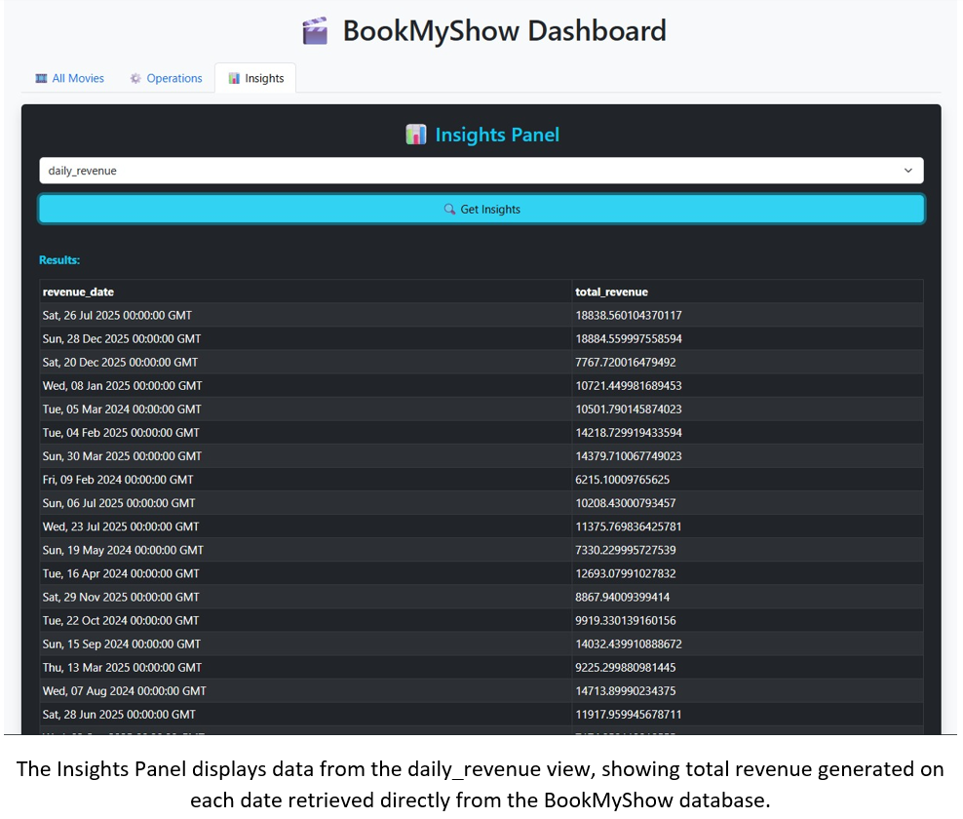

Slide 43
Project Outcome
Identified most active users and repeat customers for loyalty programs.
Discovered top-performing movies, languages, and genres for targeted marketing.
Recognized theaters with low occupancy for better scheduling and pricing optimization.
Improved payment efficiency by analyzing failures and refunds.
Leveraged user reviews to understand content preferences and satisfaction.
4-11-25
Department of Artificial Intelligence & Machine Learning
29

Slide 44
Future Aspects
Add Graphs to represent the insights better.
Using Book-My-Show API to make the data up-to-date and Realtime.
Deploy the website for laptops ,tablet and mobile.
4-11-25
Department of Artificial Intelligence & Machine Learning
30

Slide 45
Conclusion
The project successfully demonstrated how SQL-based analysis can transform raw transactional data into actionable insights for BookMyShow. By focusing on user behavior, theater efficiency, revenue optimization, and payment system reliability, the platform can enhance overall customer experience and improve profitability.
4-11-25
Department of Artificial Intelligence & Machine Learning
31

Slide 46
References
BookMyShow official website – https://www.bookmyshow.com
Kaggle - https://www.kaggle.com/soumenduray99
MySQL Documentation – https://dev.mysql.com/doc
Dataset: Synthetic dataset created for project purposes (not official BookMyShow data)
4-11-25
Department of Artificial Intelligence & Machine Learning
32

Slide 47
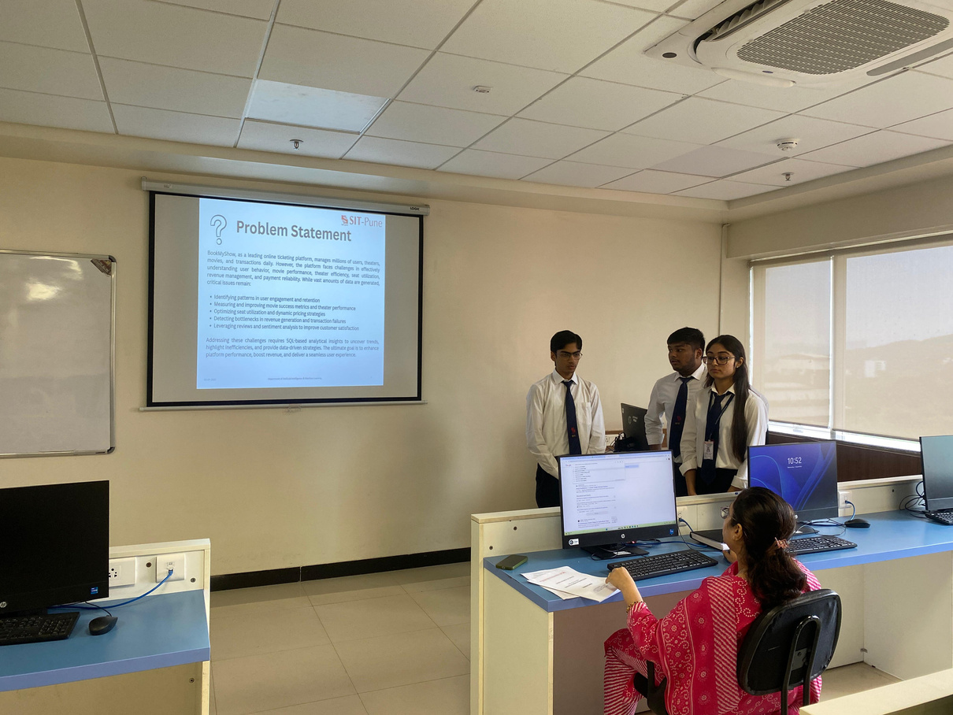
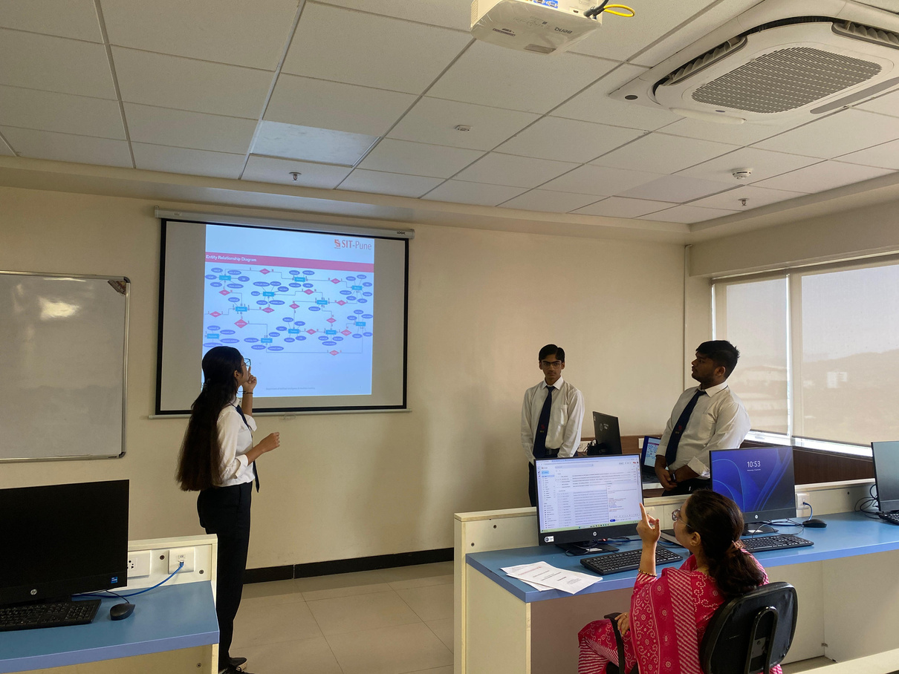
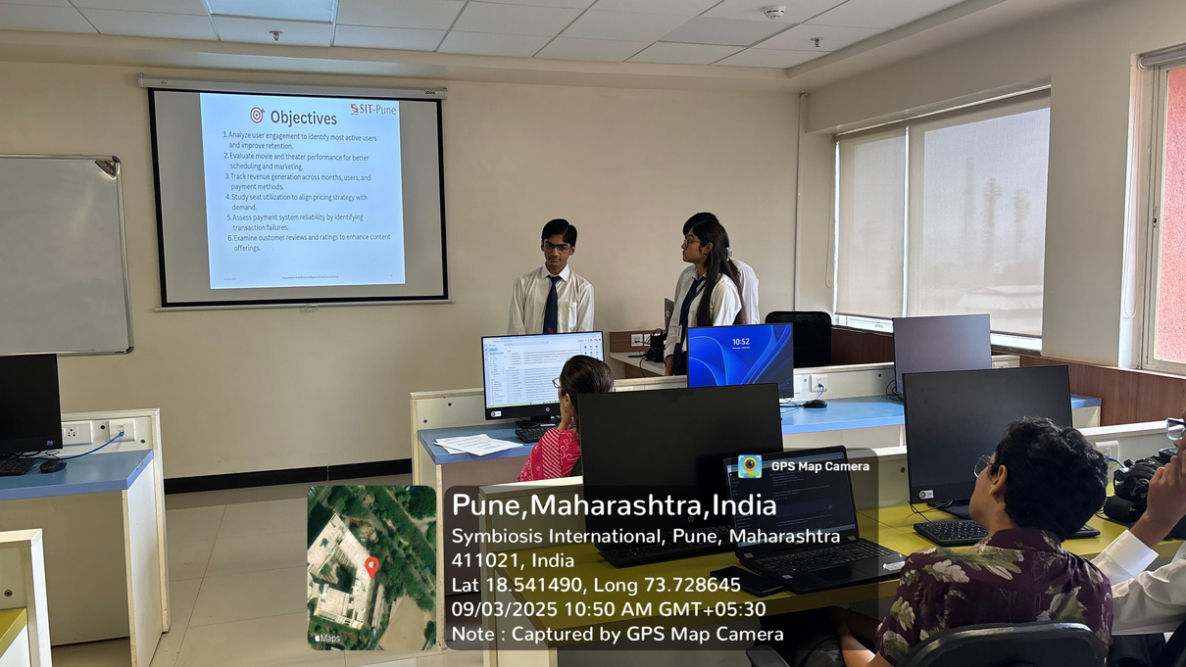
Phase 1-Presentation
4-11-25
Department of Artificial Intelligence & Machine Learning
32

Slide 48

4-11-25
Department of Artificial Intelligence & Machine Learning
32

